Slide 1
205 Mon Jan 29, Class 11
Interpreting data from factorial designs, part 1
Levav & Argo (2010)
Assefi & Garry (2003)
Discussion of Experiment 2

Slide 2
Choosing where to sit
In a study of interpersonal closeness, researchers primed either independence or interdependence by writing out reasons why they thought of themselves as similar or different from their close friends and family.
Participants were then were asked to take a seat in a waiting area full of chairs where a jacket indicated the presence of another person.
Data from men and women in the study were considered separately
The dependent variable measured was the number of chairs between the jacket and the chosen seat.

Slide 3
 | Men | Women
Independent
Interdepdendent
6.1
4.5
4.3
2.7

Slide 4
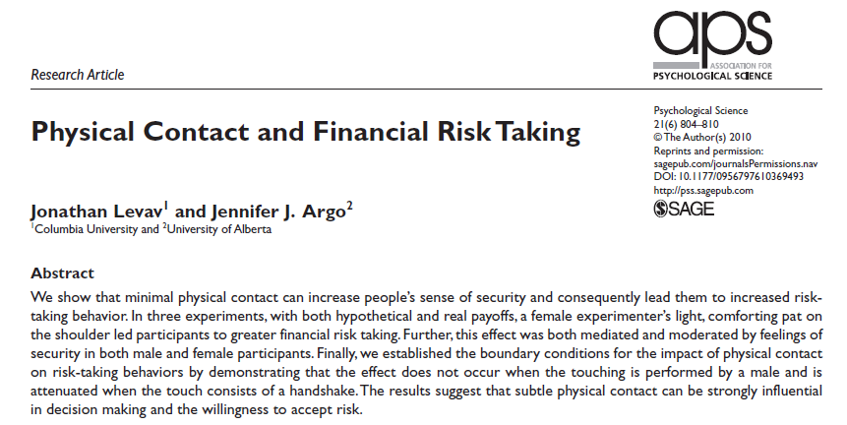
Levav & Argo (2010)

Slide 5
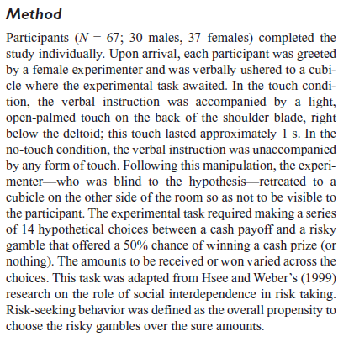
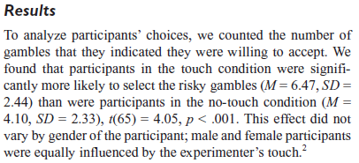
Design, Experiment 1

Slide 6
Assignment Question 1
Experiment 1 is a simple two group study.
The procedure for implementing the independent variable is described as “In the touch condition, the verbal instruction was accompanied by a light, open-palmed touch on the back of the shoulder blade, right below the deltoid; this touch lasted approximately 1 s. In the no-touch condition, the verbal instruction was unaccompanied by any form of touch. Following this manipulation, the experimenter — who was blind to the hypothesis—retreated to a cubicle on the other side of the room so as not to be visible to the participant.”
Why does this operational definition of “touch” need such an elaborate description?

Slide 7
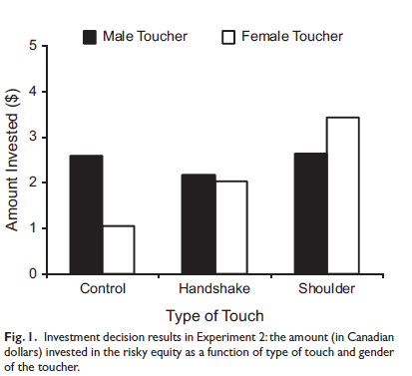
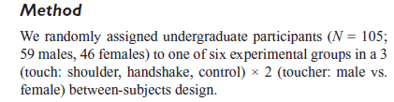
Experiment 2

Slide 8
Assignment Questions 2-5
Experiment 2 uses a factorial design. How many factors are there and how many levels of each factor?
What is the dependent variable in Experiment 2?
List the hypotheses tested by this design.
What kind of interaction is shown in Figure 4 (Experiment 3)

Slide 9

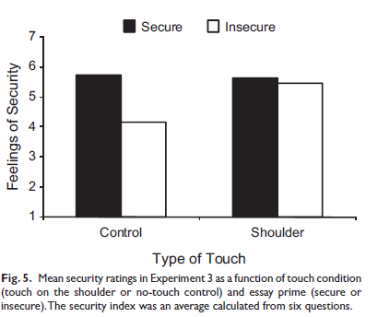
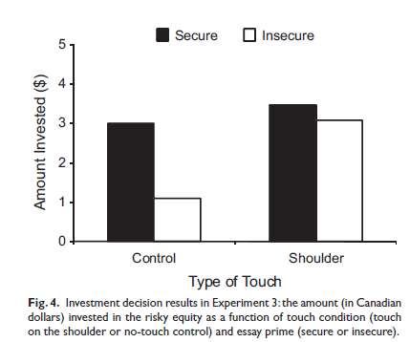
Experiment 3
Operational definition, Security:
We primed feelings of security or insecurity in a laboratory room by having participants write a brief essay about a time in their life when they “felt secure and supported” (secure-essay condition) or a time in their life when they “felt insecure and alone” (insecure-essay condition).

Slide 10
Chapter 10: Factorial design outcomes
1 main effect
Or the other main effect
2 main effects with no interaction
Effects add up
Super-additive interaction
Bigger effect in one condition
3:1 interaction
Little to no effect in one condition
Cross-over interaction
Effect inverts across conditions

Slide 11
Experiment 2
Memory for pictures/images
Usually very good
“Picture superiority” effect
How does “deep encoding” work?
How would this process be affected by more or less meaningful pictures?

Slide 12


Slide 13
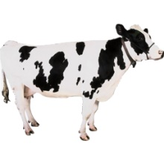

Slide 14
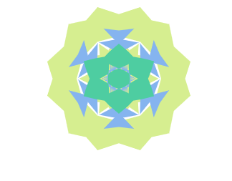

Slide 15
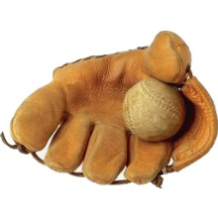

Slide 16
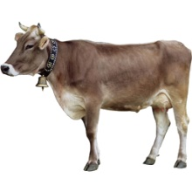

Slide 17
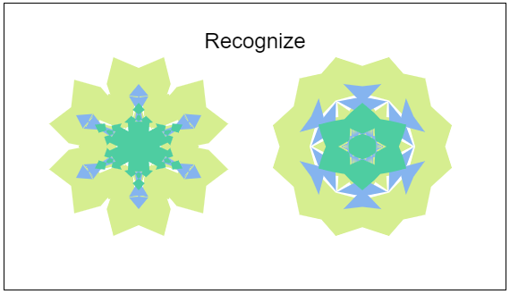

Slide 18
Operational definitions
Deep?
Shallow?

Slide 19
Factorial diagram
 |  | Type of Picture
 |  | Meaningful | Abstract
Type of Study | Deep
 | Shallow

Slide 20
For Wed Jan 31
Chapter 10
Test out Exp2 for pilot testing
Report back subjective impressions of the design

